Slide 1


INDIAN PREMIER LEAGUE(IPL) ANALYSIS
Presented by –Nabeesh R

Slide 2


Introduction
Cricket, one of the most popular sports globally, generates vast amounts of data, including ball-by-ball match details, player performances, and team statistics. This project focuses on analyzing cricket match data using MySQL to extract valuable insights and answer complex queries.

Slide 3




Overview
Location
Matches hosted across major cricket stadiums in India.
Teams
Ten city-based teams compete fiercely.
Format
Twenty20 cricket, offering fast-paced, exciting matches.
Schedule
Typically spans over two months, April to May.

Slide 4
OVERVIEW OF DATA SET
Table: Player
Column: Player_Id, Player_Name, Batting_Hand, Bowling_Skill, Country
Purpose:
To store basic information about players participating in matches.
Insights: Track individual contributions like runs scored and wickets taken to highlight top performers. Understand trends based on player roles, nationality, and playing style.
Table: Ball_By_Ball
Column: Match_Id, Innings_No, Over_Id, Ball_Id, Striker_Id, Non_Striker_Id, Bowler_Id, Batsman_scored, Extra_Runs, Dismissal_Type, Fielder_Id
Purpose:
To store granular details about every ball bowled in a match, including the runs scored, extras, and dismissals.
Insights:Track individual contributions like runs scored and wickets taken to highlight top performers. Understand trends based on player roles, nationality, and playing style.
Table: Match
Column: Match_Id, Season_Id, Team1_Id, Team2_Id, Winner_Team_Id, Venue_Name, Match_Date
Purpose:
To provide metadata about each match, including participating teams, results, and location.
Insights: Assess team performances by comparing wins, losses, and seasonal trends. Identify venues with the highest-scoring matches or most home-team wins.

Slide 5
OVERVIEW OF DATA SET
Table: Team
Column: Team_Id, Team_Name, Coach_Name, Home_Venue
Purpose: To provide details about teams participating in matches.
Insights: Examine team consistency by analyzing win rates and home-ground advantages. Compare head-to-head match records to assess rivalries and dominance.
Table: Season
Column: Season_Id, Season_Year, Winner_Team_Id
Purpose: To organize matches into seasons and record the seasonal winner.
Insights: Identify seasonal champions and their winning strategies. Analyze historical trends to find teams with consistent performances across multiple seasons.
Table: Player_match
Column: Match_Id, Player_Id, Batting_Position, Runs_Scored, Balls_Faced, Fours, Sixes, Wickets_Taken, Overs_Bowled, Maidens, Runs_Conceded, Catches, Stumpings, Run_Outs
Purpose: Captures individual player statistics for each match.
Insights: Assess player impact through metrics like runs scored, wickets taken, and fielding contributions.

Slide 6
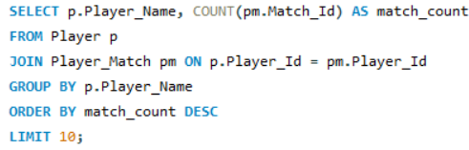
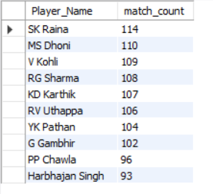
AQUEST:1
1. Determine the players with the highest number of appearances across all matches, showcasing their longevity, consistency, and importance to their respective teams throughout the league's history.
SQL QUERY
OUTPUT

Slide 7
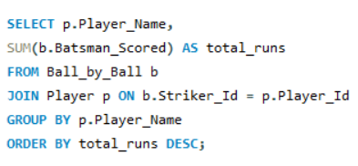
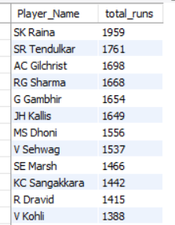
AQUEST:2
2. Calculate the aggregate runs scored by each player across all matches in the IPL, highlighting consistent performers and top scorers who significantly contributed to their team's success over the seasons.
SQL QUERY
OUTPUT

Slide 8
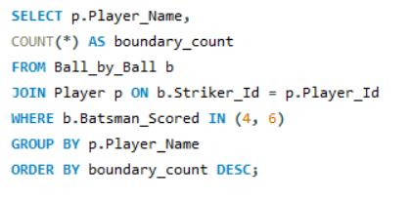
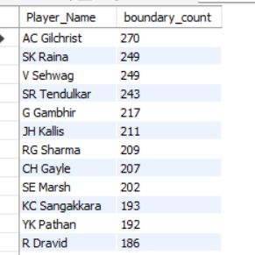
AQUEST:3
3. Find the relative rank of each player’s total runs scored. Identify the player who has hit the highest number of boundaries (fours and sixes) across all matches, showcasing their dominance as an aggressive batsman and their contribution to the team's scoring efficiency.
SQL QUERY
OUTPUT

Slide 9
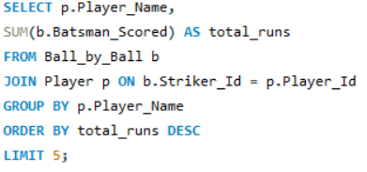
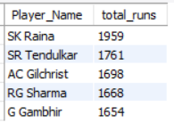
AQUEST:4
4. Identify the five players with the highest total runs scored across all matches, highlighting their exceptional batting performance and impact on their teams’ success in the league.
SQL QUERY
OUTPUT

Slide 10
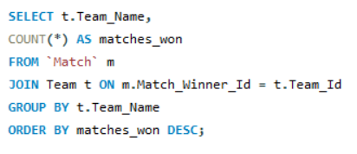
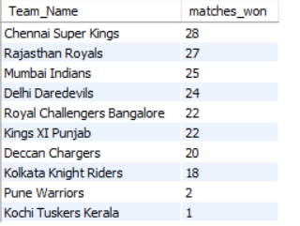
AQUEST:5
5. Calculate the total number of matches won by each team across all seasons, providing insights into team dominance, consistency, and overall success in the league.
SQL QUERY
OUTPUT

Slide 11
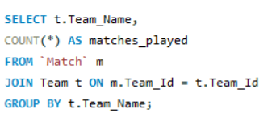
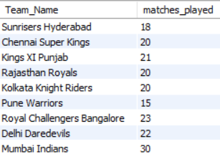
AQUEST:6
6. Determine the total number of matches played by each team across all seasons, offering insights into their participation, consistency, and overall presence in the league.
SQL QUERY
OUTPUT

Slide 12
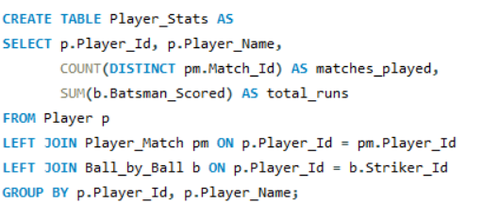
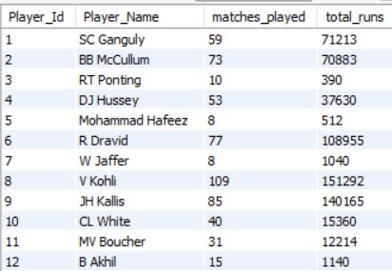
AQUEST:7
7. Generate a table that summarizes the total runs scored and the number of matches played by each player, offering a comprehensive view of individual contributions and consistency across the league.
SQL QUERY
OUTPUT

Slide 13
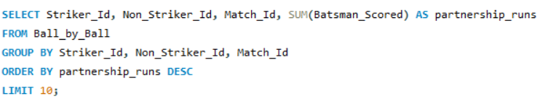
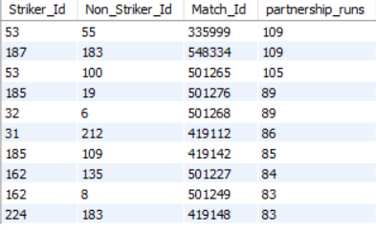
AQUEST:8
8. Identify the batting pairs that have scored the highest partnership runs in a single innings, showcasing key moments of collaboration and match-winning efforts in cricket history.
SQL QUERY
OUTPUT

Slide 14
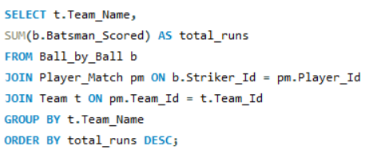
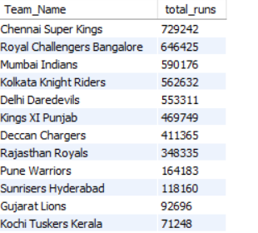
AQUEST:9
9.Calculate the aggregate runs scored by each team across all matches, providing insights into team batting strength and consistency over the Seasons.
SQL QUERY
OUTPUT

Slide 15
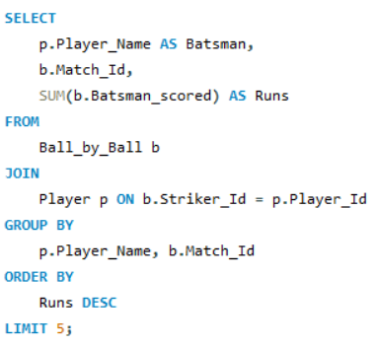
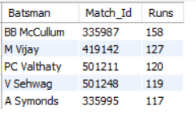
AQUEST:10
10. Identify the batsman who scored the highest individual runs in a single match, showcasing an extraordinary performance and a standout moment in the league's history.
SQL QUERY
OUTPUT

Slide 16
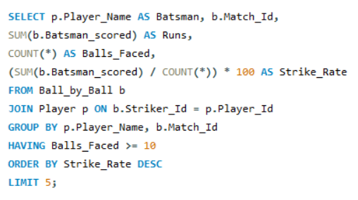
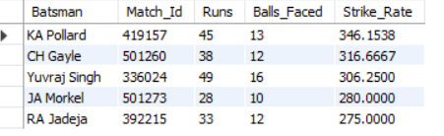
AQUEST:11
11. Identify players with the highest strike rate in individual matches, considering those who faced at least 10 balls. This highlights explosive batting performances and players capable of quick runs under pressure.
SQL QUERY
OUTPUT

Slide 17
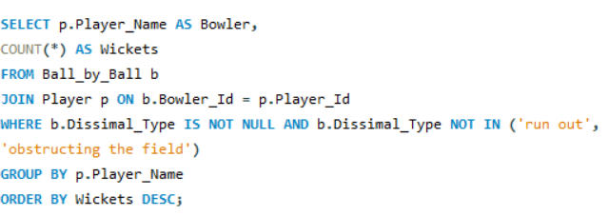
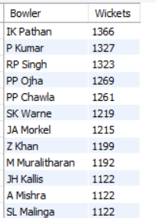
AQUEST:12
12. Calculate the total number of wickets taken by each bowler across all matches, showcasing their effectiveness and contribution to their team's success in the league.
SQL QUERY
OUTPUT

Slide 18
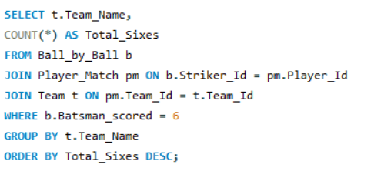
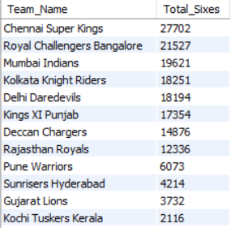
AQUEST:13
13.Identify the team that has hit the most sixes across all matches, highlighting their aggressive batting approach and ability to score quickly.
SQL QUERY
OUTPUT

Slide 19
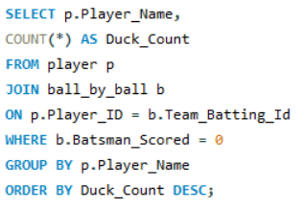
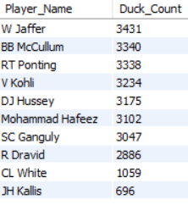
AQUEST:14
14. Identify players who have been dismissed for zero runs (ducks) across all matches, providing insights into their vulnerability and instances of underperformance in the league.
SQL QUERY
OUTPUT

Slide 20
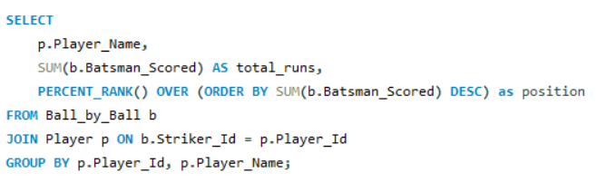
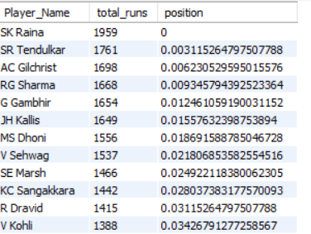
AQUEST:15
15. Determine the rank of each player based on their total runs scored relative to others. This provides a clear comparison of individual batting performances across the league .
SQL QUERY
OUTPUT

Slide 21

Conclusion
This project provides a comprehensive analysis of cricket match data, uncovering key insights about player performances, team trends, and overall league dynamics. By leveraging SQL to process and analyze datasets, we can highlight impactful players, identify team strengths, and explore match-winning strategies, offering valuable perspectives for cricket

Slide 22

Thank You!
We respect your valuable time with Slide Egg!
If you have any questions, please reach us
nabeesh-r

